Slide 1

Book shop
By Shakira team
Notes:
ملاحظة:
لتغيير الصورة على هذه الشريحة، حدد الصورة واحذفها. ثم انقر فوق أيقونة «الصور» في العنصر النائب لإدراج صوتك.

Slide 2
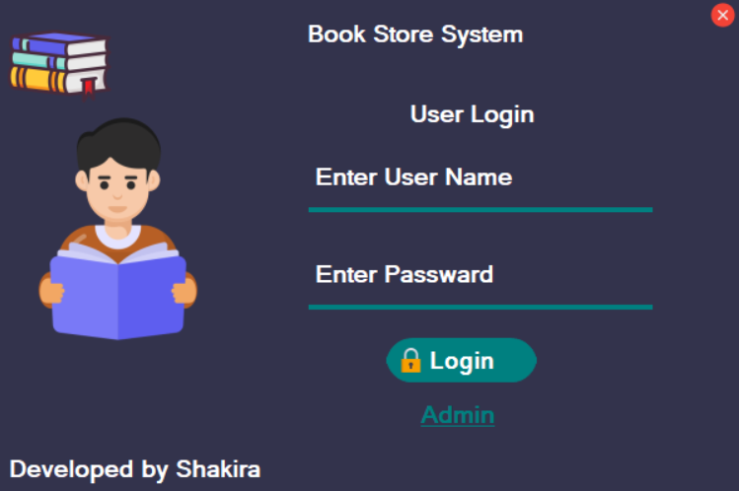
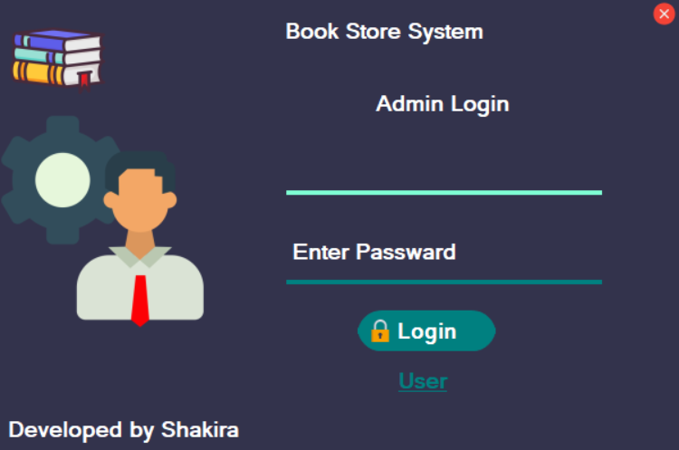
1. Login Page (Admin & User)
Description: This is the entry point of the system. It features a clean, professional interface where users can choose between two roles: Admin or Customer.
Functionality: It includes text fields for "User Name" and "Password" and a toggle button to switch between Admin login and User login.
Security: The system validates credentials. If the inputs are empty or incorrect, a "Wrong Username or Password" message box appears.

Slide 3
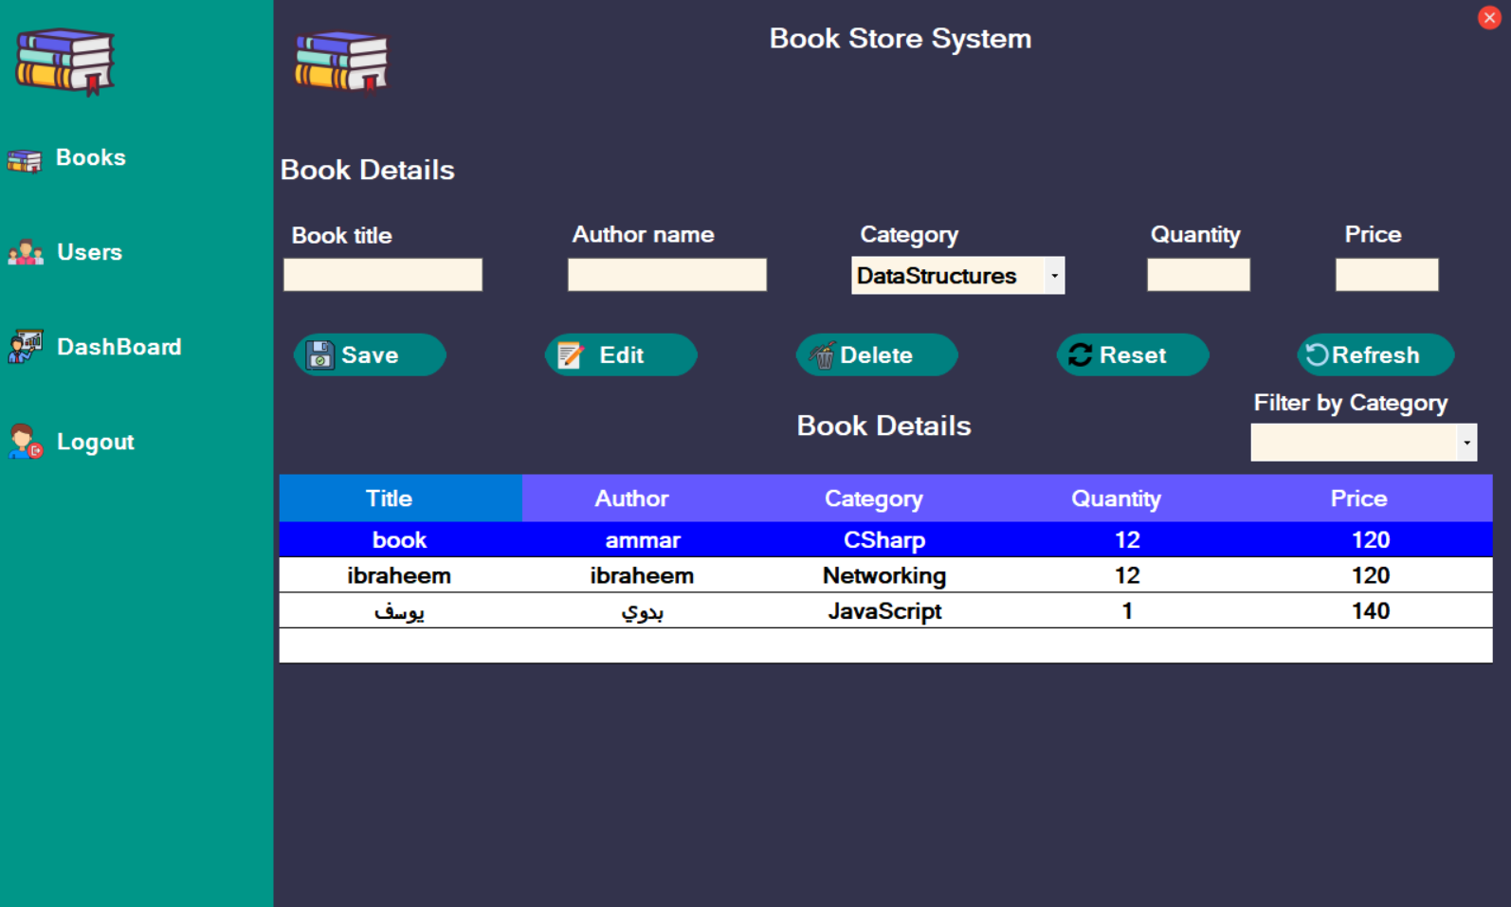
2. Books Management Page
Description: This page allows the Admin to manage the bookstore's inventory.
Key Features: It contains input fields for Book Title, Author Name, Category, Quantity, and Price.
Operations: The Admin can Save new books, Edit existing details, or Delete books from the database.
Display: A data grid at the bottom displays the list of all available books, with a "Filter by Category" option for quick searching.

Slide 4
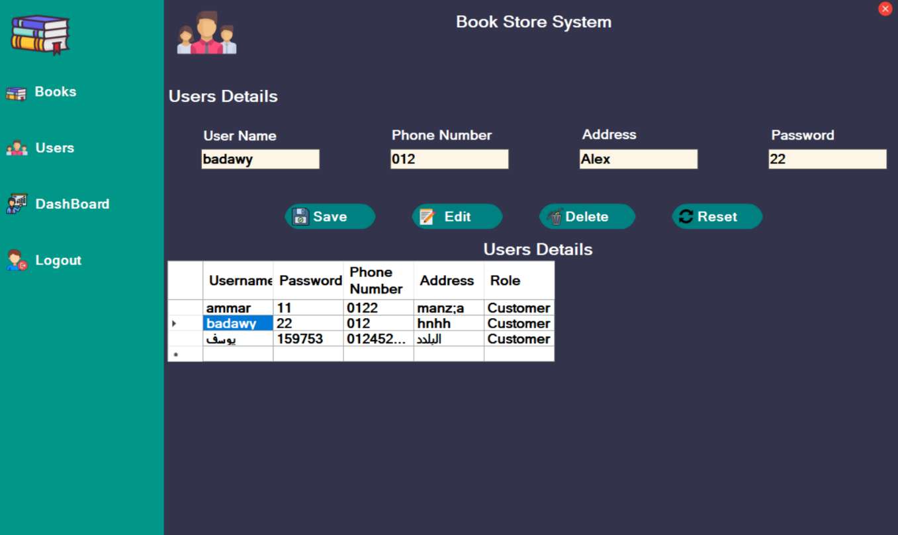
3. Users Management Page
Description: This section is dedicated to managing the people who use the system.
Functionality: The Admin can register new users by entering their User Name, Phone Number, Address, and Password.
Management: Similar to the Books page, it allows for adding, updating, and removing user accounts to maintain a secure and updated list of authorized personnel.

Slide 5
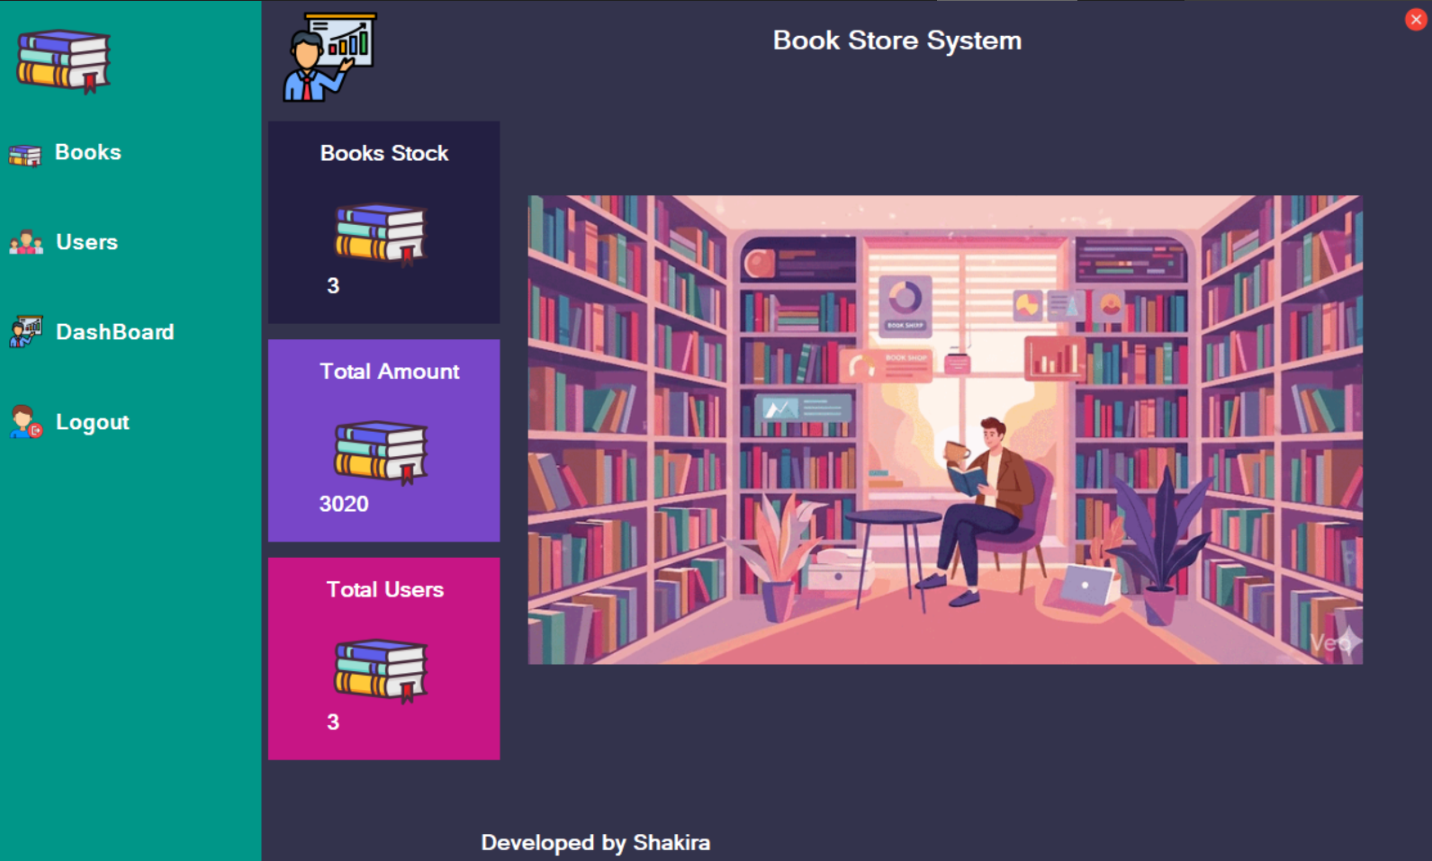
4. Dashboard (Analytics)
Description: The Dashboard provides a visual summary of the bookstore's current status.
Data Overview: It displays total counts for Books Stock, Total Users, and Total Revenue (Amount).
User Interface: It uses a visually appealing layout with icons and a background image of a library to give the Admin a quick "at-a-glance" view of the business performance.

Slide 6
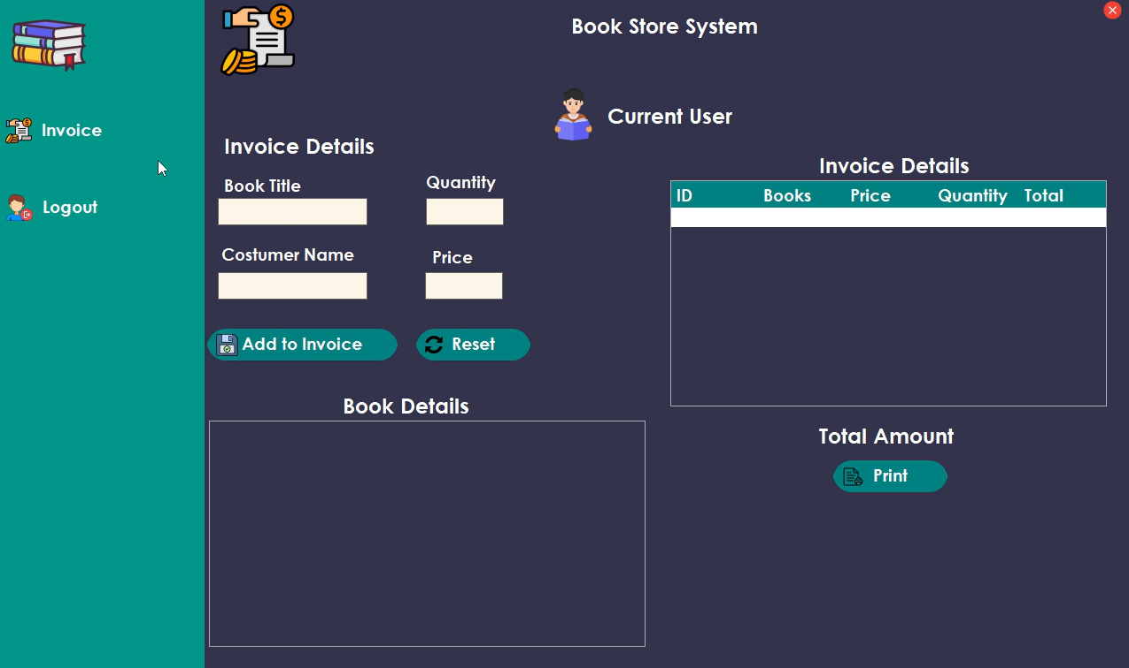
5. Billing & Invoice Page
Description: This is the operational page where transactions happen. It is used to process customer purchases.
Invoice Details: The user can select a book, enter the quantity, and the customer's name.
Automatic Calculation: The system calculates the total price automatically and adds the items to the "Invoice Details" list.
Printing: There is a Print button to generate a physical or digital receipt for the customer, and a total amount is displayed at the bottom right.

Slide 7
Abstract
The Book Store Management System is a digital solution designed to streamline bookstore operations using C# and Windows Forms. The system integrates secure multi-role authentication (Admin & User), comprehensive inventory tracking, and a dynamic billing engine. By automating stock management and financial reporting through an interactive dashboard, the application minimizes human error and enhances operational efficiency, providing a robust tool for modern retail management.

Slide 8
Thanks

